Slide 1
FN312045 - Introduction to Supply Chain Management: Exploring Workday Procurement and Workday Inventory
Workday Rising
Notes:
Welcome!

Slide 2
Saritha Surapaneni
David Farrall
Functional Architect Supply Chain Management
Corporate Director of Supply Chain
Workday
Dayton Children’s Hospital
Notes:
Welcome David here

Slide 3
Objectives of Session
 | Workday Supply Chain Management Overview Functional Footprint and Roadmap
 | Dayton Children’s Journey with Workday Supply Chain Management About Dayton Children’s and Workday Deployment Highlights and Value Realized
 | Summary / Q&A
Notes:
We will start off with a quick intro to SCM where I will provide product overview, functional footprint and a quick look at what is on the immediate roadmap.
David will take over and share DCH’s journey with WD SCM - WD Deployment, How they are using it and what is the value realized.
We will wrap-it up with Q&A
David:
Step 1 launching SCM
Step 2 What next steps did DCH Take to improve SCM

Slide 4
Customer: Dayton Children’s Hospital
David Farrall
“It starts with a Requisition” or “It starts with a REQ!”

Slide 5
Dayton Children’s Hospital: About Us

Slide 6
Dayton Children’s Hospital: About Us

Slide 7
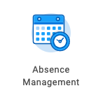
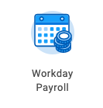
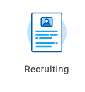
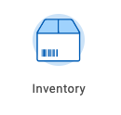
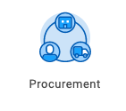
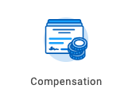
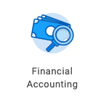
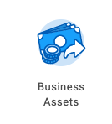
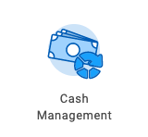
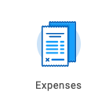
Workday Full Suite
HCM, Payroll, Financials
Live Jan 1, 2018
Supply Chain
Live April 1, 2019
Notes:
Jan 1, 2018 (WD29)
April 1, 2019 (WD32)

Slide 8
The Power of One: DCH Employee View
One application
One experience
One source of the truth

Slide 9
Deployment Considerations

Slide 10
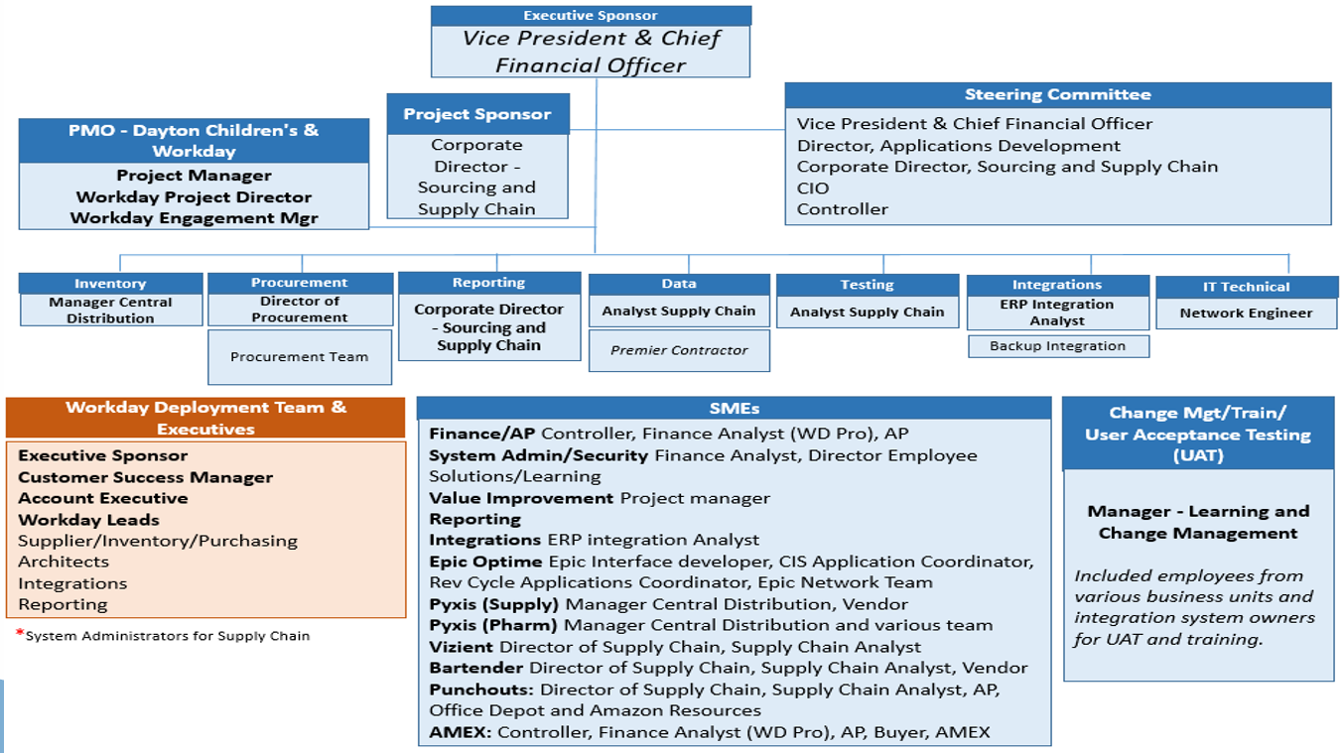
Project Team & Governance Structure

Slide 11
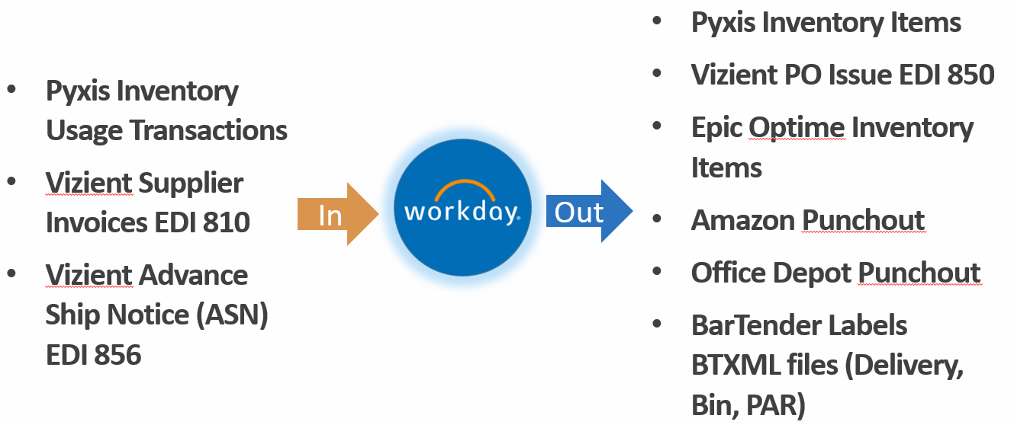
Workday Integrations

Slide 12
E2E Testing Jan 2019

Slide 13
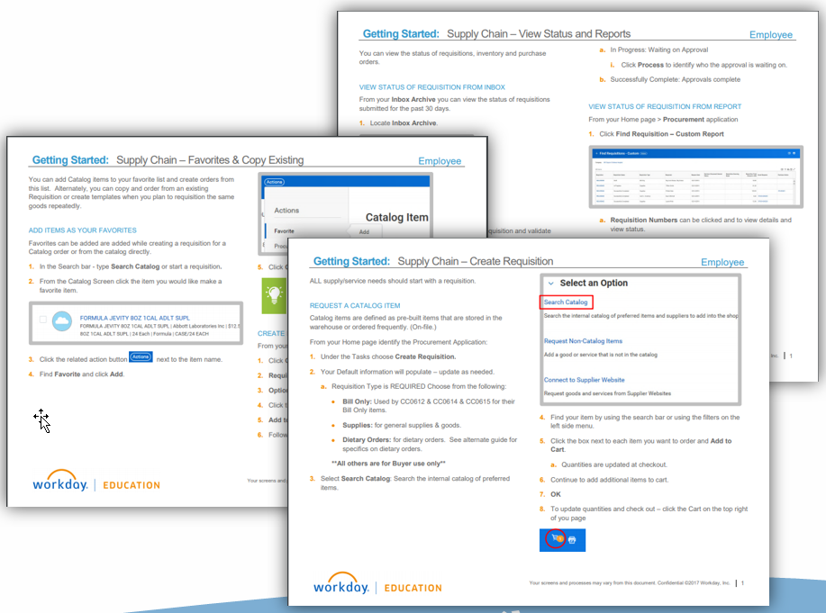
Training Objectives & Guides
Understand the different requisition types.
Review fields of a requisition.
Create a requisition
Review the status if a requisition, stock request and purchase order.

Slide 14
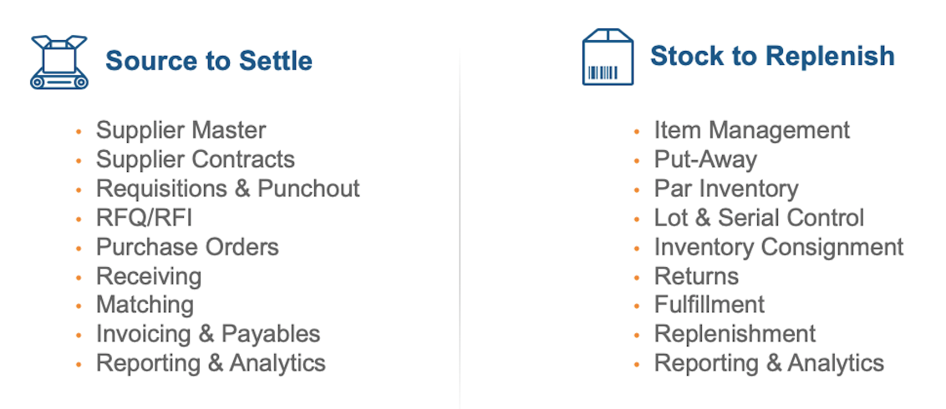
Workday SCM Scope

Slide 15
Powerful, Real-Time Analytics

Slide 16
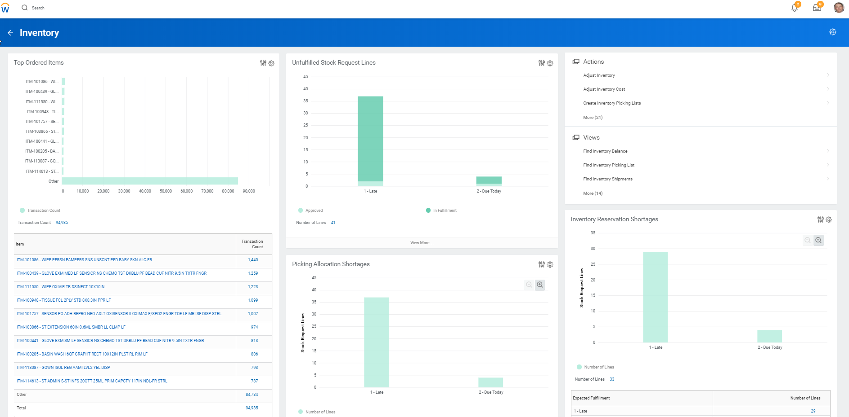
Leveraging Dashboards
Analytics and transactions in the same system

Slide 17
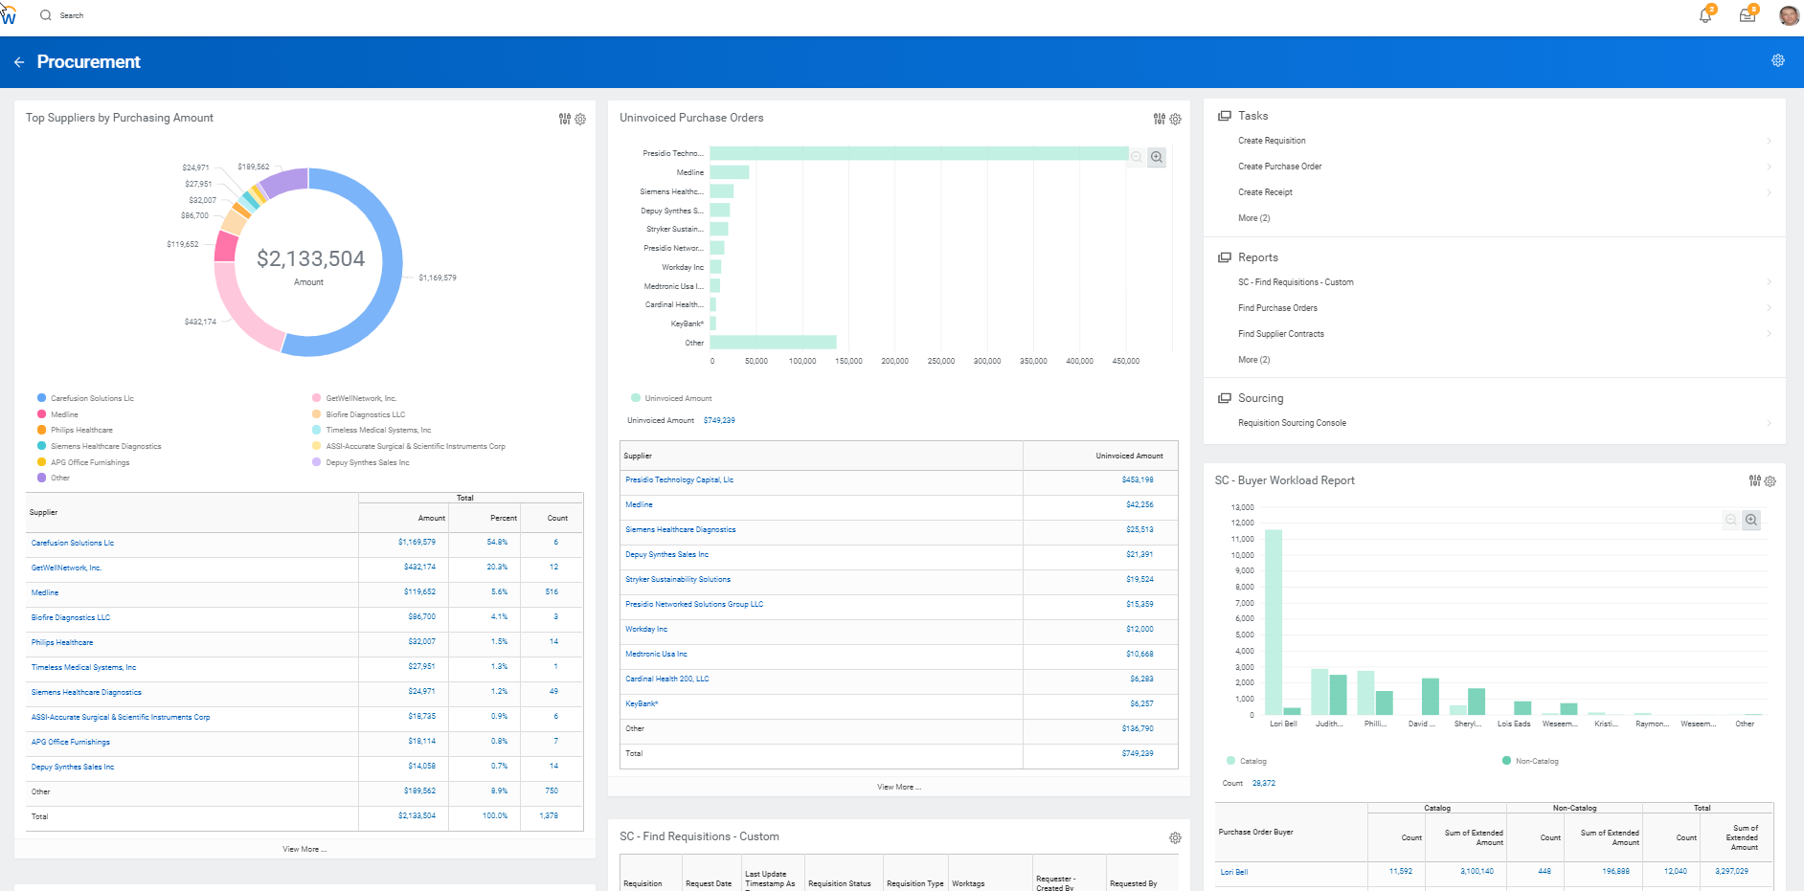
Procurement Dashboard
Top Suppliers by Purchasing Amount
Uninvoiced Purchase Orders
Buyer Workload

Slide 18
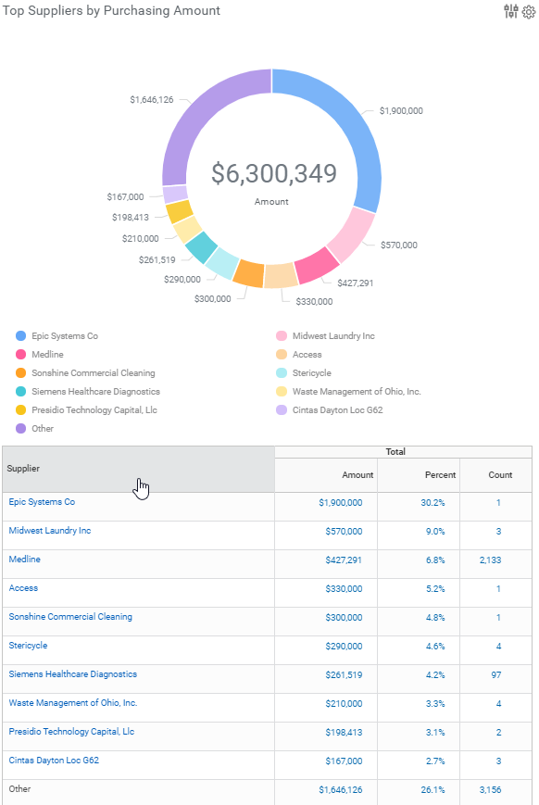
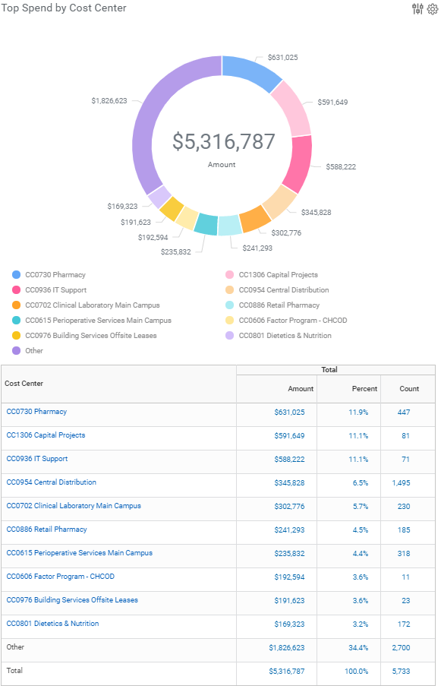
Procurement Dashboard

Slide 19
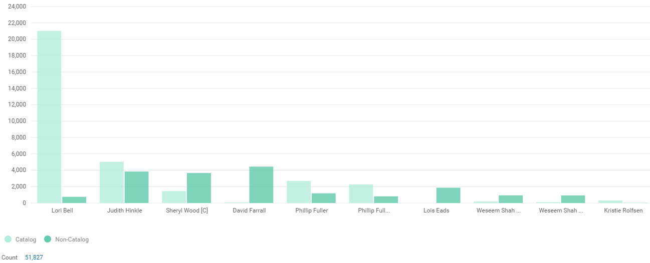
Buyer Workload

Slide 20
Buyer Workload – Detailed View

Slide 21
Inventory Dashboard
Top Ordered Items
Unfulfilled Request Lines
Picking Allocation Shortages
Inventory Reservation Shortages

Slide 22
Inventory Dashboard - Top Ordered Items

Slide 23
Inventory Unfilled Dashboards

Slide 24
Powerful, Real-Time Analytics Cross-Functional Reporting for Managers and Directors

Slide 25
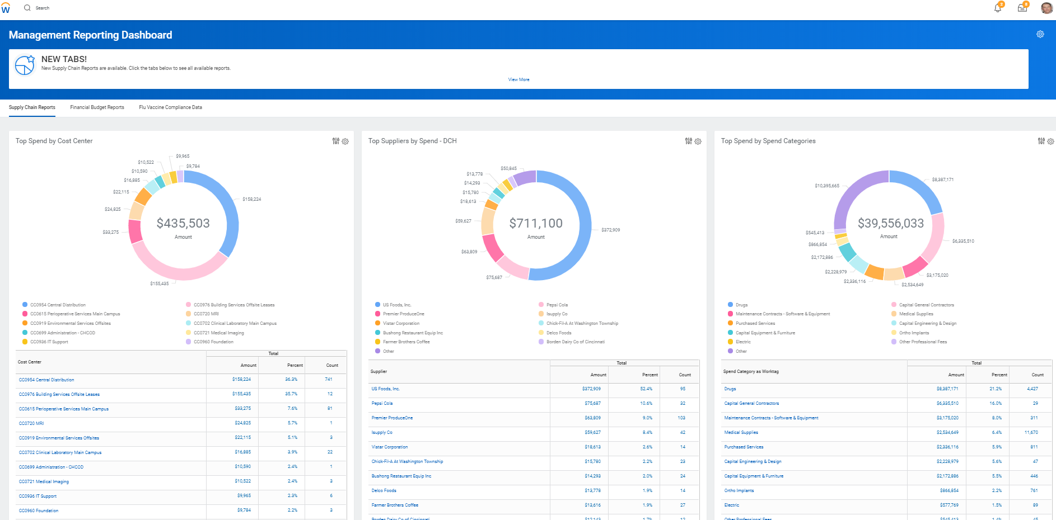
Management Reporting Dashboards
Dashboard Tabs
Supply Chain Reports
Financial Budget Reports
Flu Vaccine Compliance Data

Slide 26
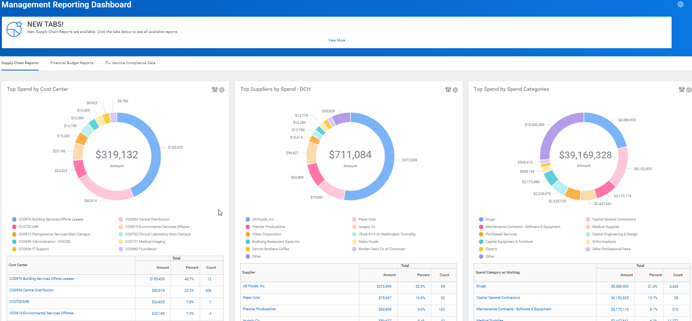
Management Reporting Dashboard - Supply Chain
Supply Chain Dashboard
Top Spend by Cost Center
Top Suppliers by Spend
Top Spend by Spend Categories
Uninvoiced Purchase Orders
Top Spend By Catalogs
Total Spend- PO and Non-PO Invoices

Slide 27
Management Reporting Dashboard – Supply Chain

Slide 28
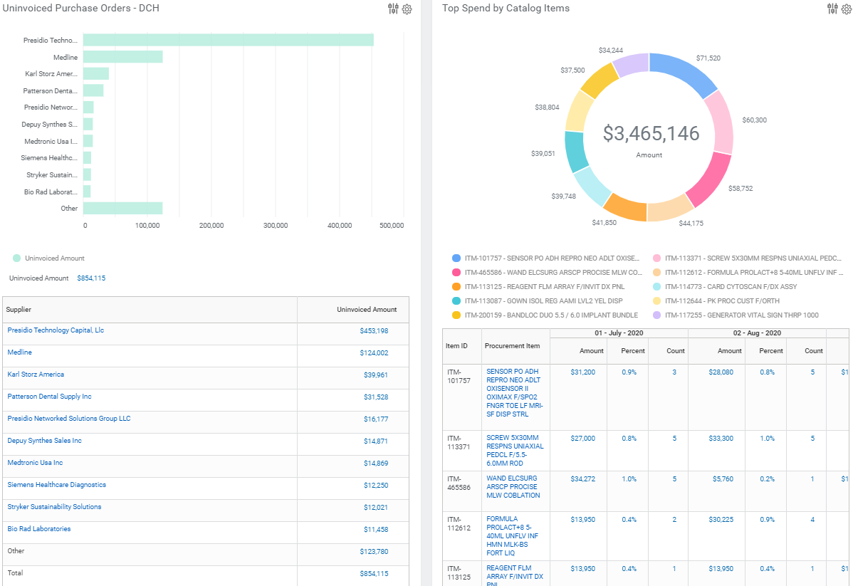
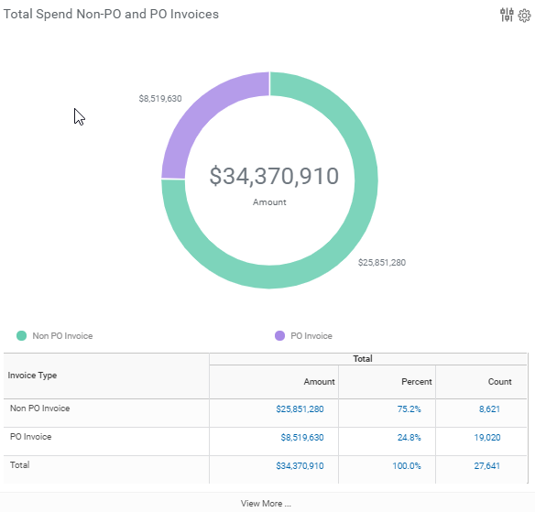
Management Reporting Dashboard – Supply Chain
View More takes end users to report details

Slide 29
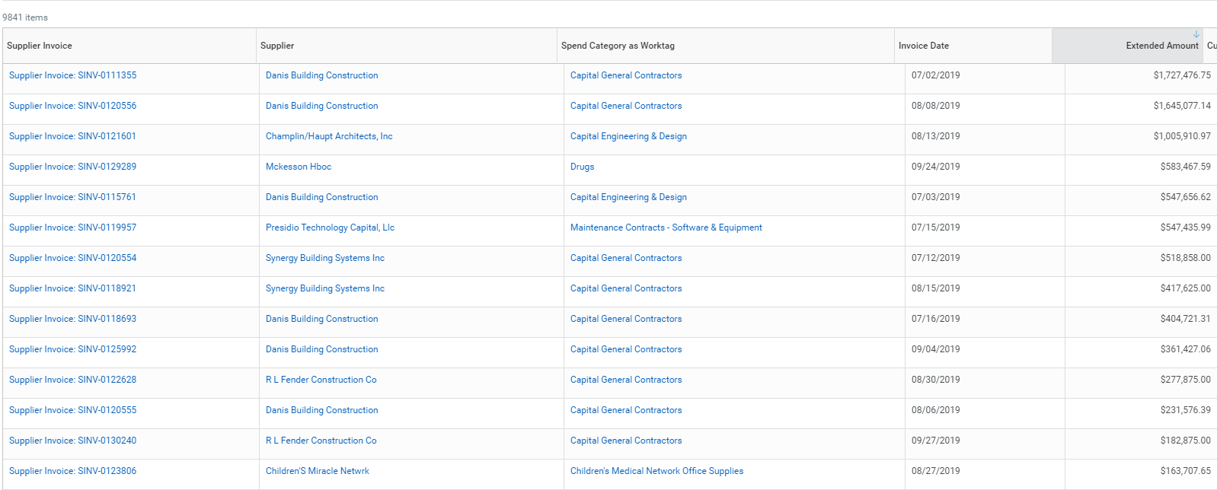
Top Spend Non PO Invoices – Detailed View

Slide 30
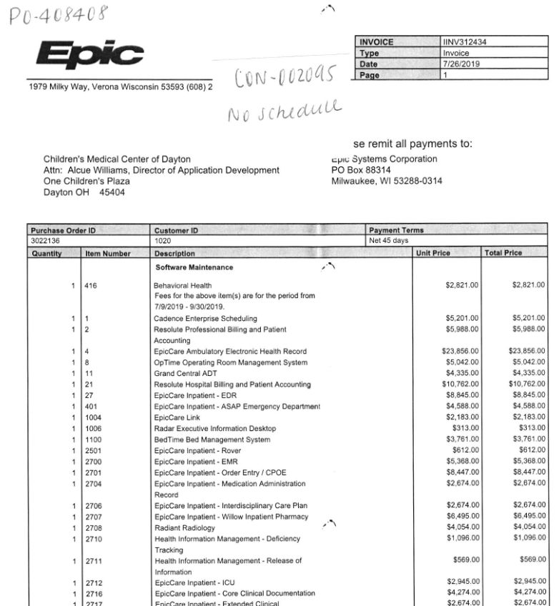
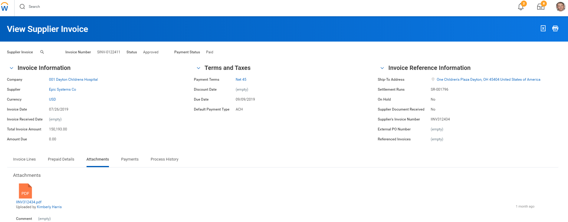
View Supplier Invoice
Notes:
Maybe add the laptop and still show the invoice on the screen. It will be small enough but the message about drilling down can be reviewed.

Slide 31
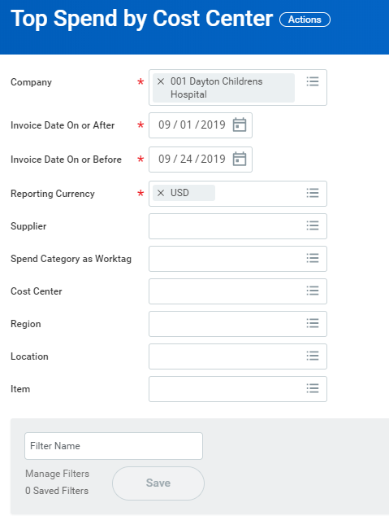
Management Detailed Reporting

Slide 32
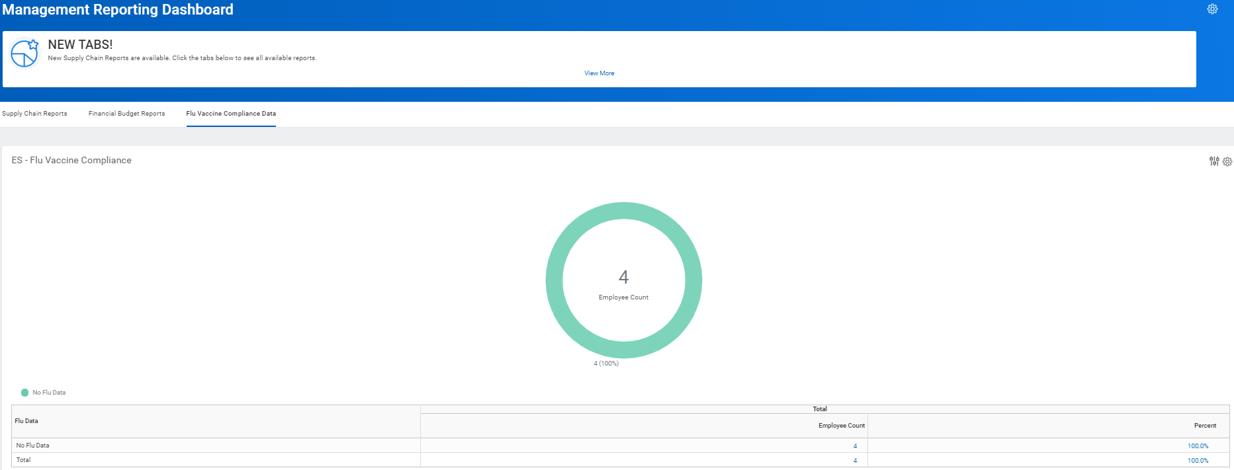
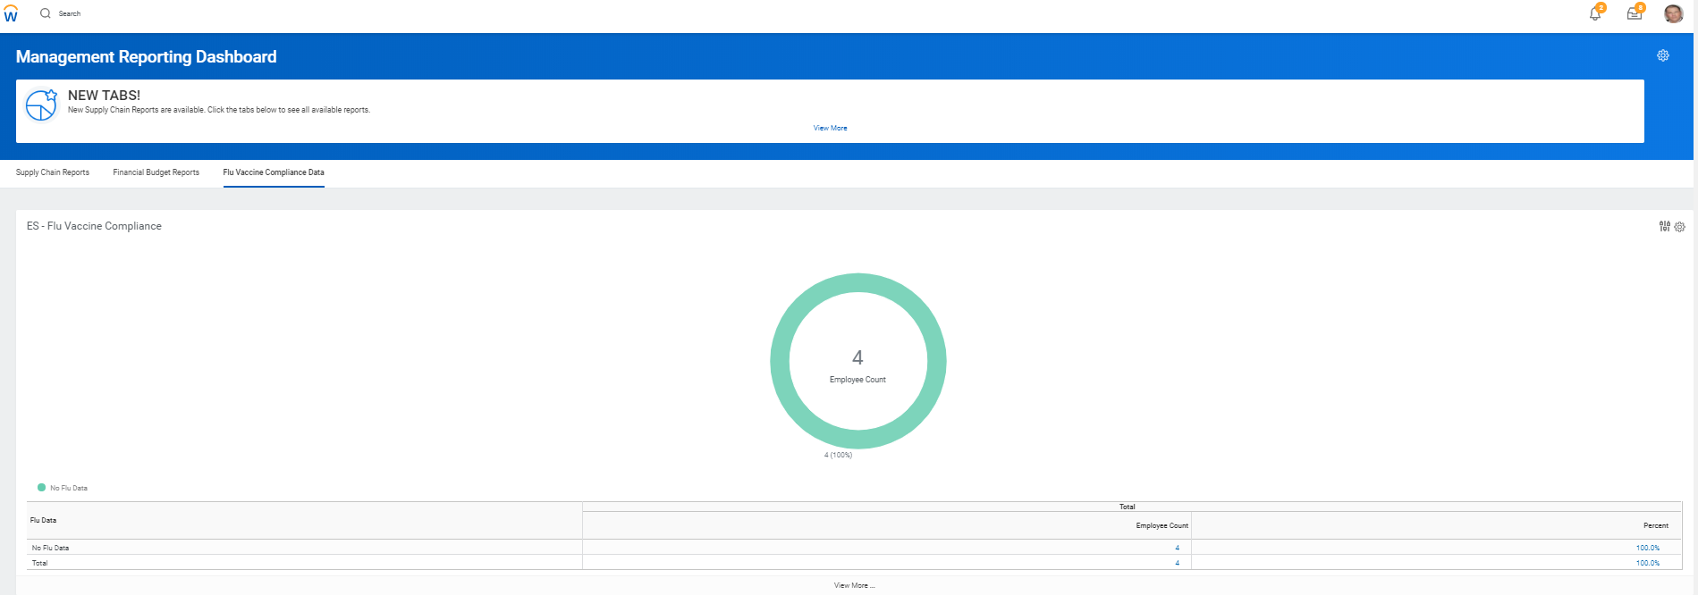
Healthcare – Compliance Data

Slide 33
Supplier Contracts
Creating a Contract Repository

Slide 34
Supplier Contract Types
41 different types of Contract types
The reason is for searching (outside of supply chain)

Slide 35
Supplier Contracts
DCH has loaded 559 total T&C contracts
Naming convention:
Department name
Department #
Type of agreement
Naming convention:
4 Digit code
Name of supplier
Contract #

Slide 36
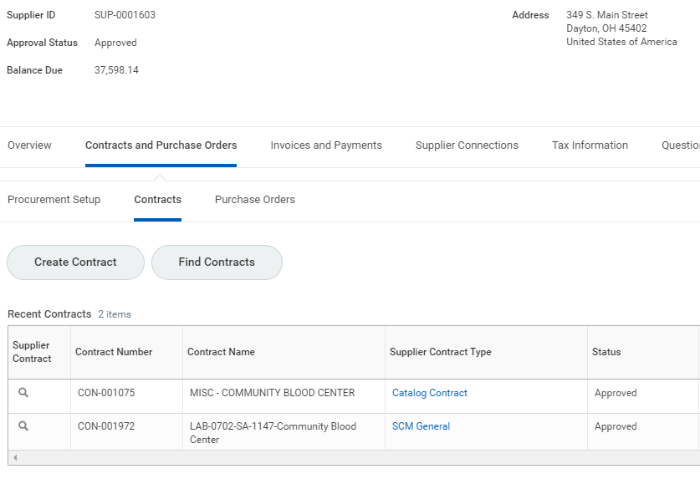
Example of Searching

Slide 37
Key Takeaways for Mutual Success
1
2
3
Learn about key product capabilities in Supply Chain Management.
Hear from a customer about their journey with Workday Supply Chain Management.
Get a sneak peek at enhancements planned for future product releases.

Slide 38
Q&A

